Slide 1
Weekly Progress
Sem 2 Week 1

Slide 2
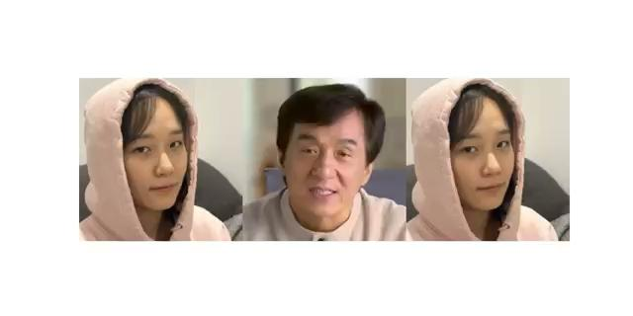
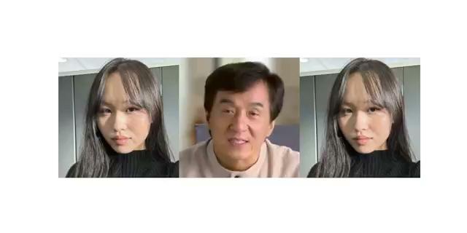
Head pose implementation
Input image → Pose video → Output

Slide 3
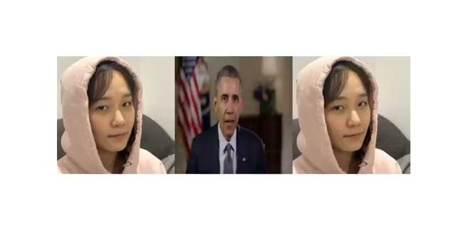
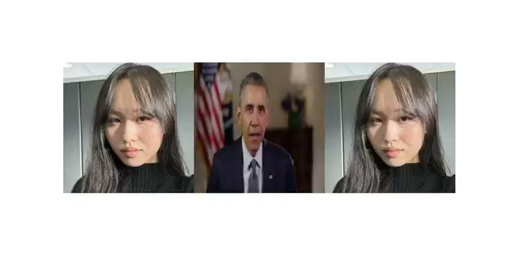
Head pose implementation
Input image → Pose video → Output

Slide 4
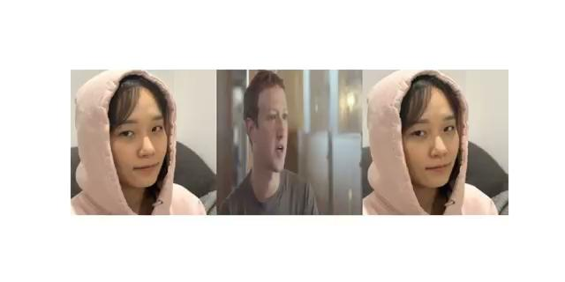
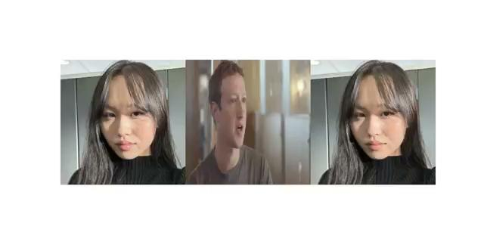
Head pose implementation
Input image → Pose video → Output

Slide 5
Things to do
Integrate image cropping stage, head pose stage and lip synchronisation stage in one python file for demo on Saturday
Improve head pose

Slide 6
Emotion generator
Currently processing on training
Docker 2 : works
Docker 4 : does not work(why?)
Audio read error- backend read error

